Slide 1
Classifier System for application-level Mobile Traffic Project defance Yair Ivgi and Johann Thuillier Supervisor : Dr. Dvir Amit Department of Computer Science Ariel university

Slide 2
Table of contents
1. Background
2. Objectives
3. System Architecture
4. Results
5. Difficulties
6. Conclusions
7. Future Developments

Slide 3

Background
With the increasing proliferation of smartphones, the amount of sensitive data increased drastically.
Numerous studies have shown that encryption isn’t enough to protect entirely confidentiality. In fact, Machine Learning techniques can classify user’s parameter like OS, browser and application.
However, most of these studies deals with Computer traffic. This, raises a fairly critical question:
“What about Mobile traffic Classification?”

Slide 4
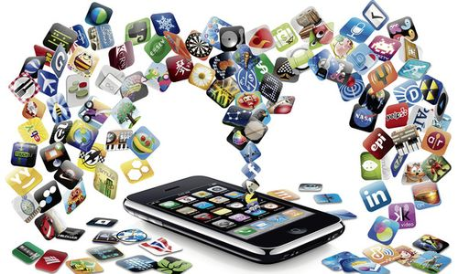
We present a system to identify the user’s application. To achieve this goal, we offer an automated classifier system for application-level mobile traffic that is using only the features that remain intact after encryption.

Slide 5
Related Work
Robust Smartphone App Identification Via Encrypted Network Traffic Analysis.
by Vincent F. Taylor, Riccardo Spolaor, Mauro Conti and Ivan Martinovic.
Upgraded AppScanner it is a highly-scalable and extensible framework for the fingerprinting and identification of apps from their network traffic.
The Dark Side(-Channel) of Mobile Devices: A Survey on Network Traffic Analysis.
by Mauro Conti, QianQian Li, Alberto Maragno, and Riccardo Spolaor.
They review the works that contributed to the state of the art of network traffic analysis targeting mobile devices.

Slide 6
Objectives
The

Slide 7
System Architecture
The system consist of four main parts:
Network trace capture.
Dissecting the data to sessions.
Features extraction, creating CSV files with labeled vectors
Running different Machine Learning algorithms

Slide 8

Network trace capture
The main feature that distinct our project from previous works is the recording method.
We used iPhone 7 and OnePlus 6 to see the results also for IOS and Android devices.
We recorded around 2.7 GB of traffic data as Pcap files.
The recording was mad by using the support of Flash Networks Inc.
Flash Networks has the largest market share in the mobile Internet optimization and monetization market with hundreds of deployments, and they provided us their servers and software for research
Data
1.Iphone 7 1.3 gb
2.OnePlus 6 1.4 gb
3. All Data 2.7

Slide 9




Dissecting the data to sessions.
We used open source Pcap file splitter named SplitCap.
Each Pcap file was dissected to TCP and UDP sessions, the packets was grouped by five parameters and it’s bi-directional (both direction are considered part of the same session) :
Source ip , Destination ip , source port , destination port and protocol.
Each session was saved as a separate Pcap file.

Slide 10
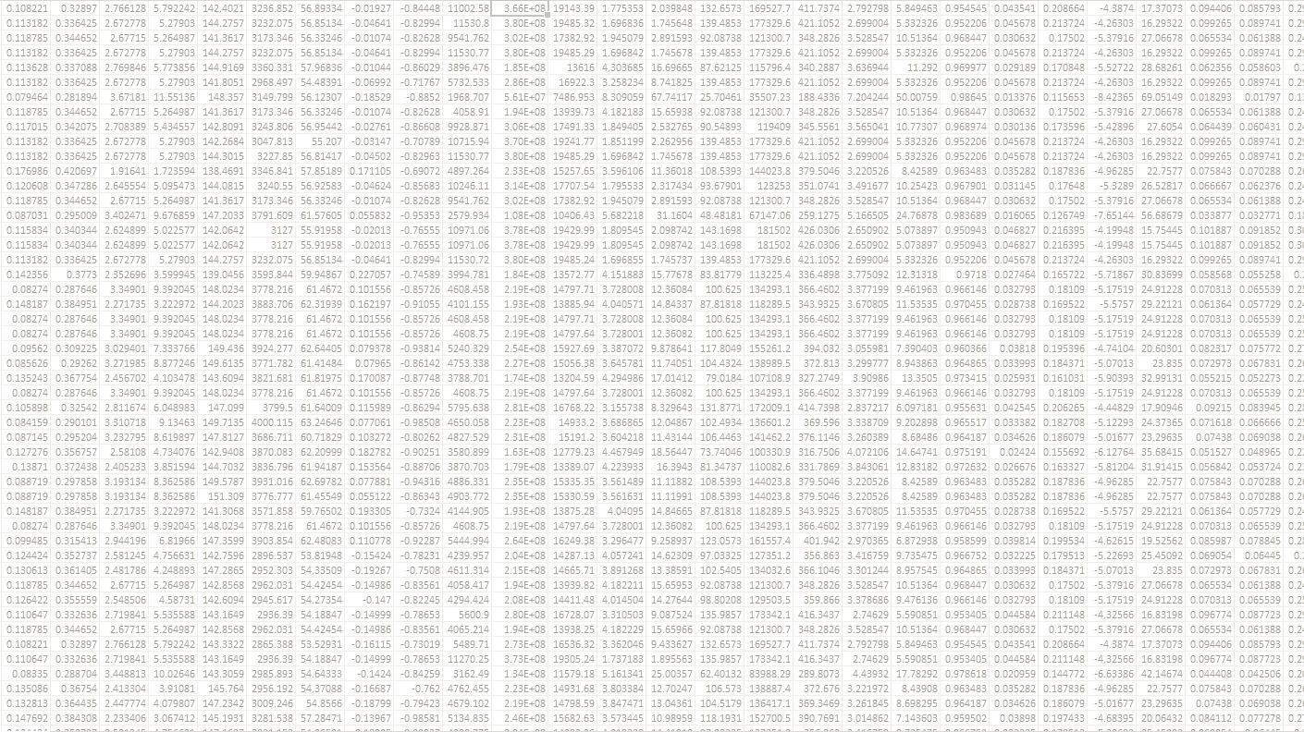
From features extraction to datasets
The analysis of the each Pcap file (session) manifested by extracting different features from the TCP layer of the packets.
For each session we created a vector of the computed features
The SNI – server name indicator is used to label each vector’ session with the corresponding Application.
All vectors are added to a CSV file that build our dataset.
We build two features set: type A and type B.
We create 4 different datasets.

Slide 11


Features Extraction
creation of 2 different features sets
Type: | A | B
Tool: | Pcap4J | T-Shark

Slide 12
Features set A
session_id_length comp_methods_length extension_len cipher_suites_length handshake_version ip_ttl window_size mss_val wscale_shift flags_ack flags_syn flags_reset
Features set B
Total number of packets Mean of packet size Variance of packet size Max packet size Min packet size Packets in forward direction Packets in backward direction Bytes in forward direction Bytes in backward direction Min forward inter-arrival time Min backward inter-arrival time Max forward inter-arrival time Max backward inter-arrival time Standard deviation of forward inter- arrival times Standard deviation of backward inter- arrival times Mean forward inter-arrival time Mean backward inter-arrival time Min forward packet length Min backward packet length Max forward packet length Max backward packet length Std deviation of forward packet length Std deviation of backward packet length Mean forward packet length Mean backward packet length
Statistics computed for each one
Mean Variance Standard Deviation Skew Kurtosis
Total features by session:
60

Slide 13
4 Datasets Overview (csv)
Features Set A
Features Set B
Iphone dataset
1855 labeled vectors
OnePlus data set
705 labeled vectors
OnePlus dataset
450 labeled vectors
All data dataset
2560 labeled vectors

Slide 14
Machine Learning Classifier
Global classifiers comparison (Scikit-learn)
dataset = all data
train size = 0.7
Nearest Neighbors score :: 0.7594339622641509
RBF SVM score :: 0.5707547169811321
Decision Tree score :: 0.9056603773584906
Random Forest score :: 0.8160377358490566
Neural Net score :: 0.23113207547169812
AdaBoost score :: 0.7028301886792453
Naive Bayes score :: 0.5801886792452831
QDA score :: 0.3443396226415094
*classifier are tuned on default parameters

Slide 15
Machine Learning Classifier
Pros and cons of three best classifiers
 | KNN | Random Forest | Decision-Tree
Pros | intuitive and simple easy to implement for multi-class problem for Classification and Regression | extremely flexible high accuracy. | interpretable for both regression and classification problems
Cons | slow algorithm Optimal number of neighbors Imbalanced data causes problems | complexity less intuitive time-consuming | unstable tends to overfit

Slide 16
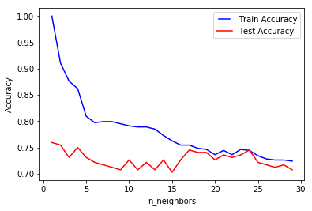
Machine Learning Classifier
Knn (Scikit-learn)
best test accuracy :: 0.7594339622641509
neighbors :: 2

Slide 17
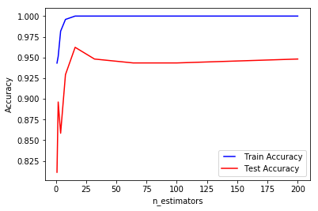
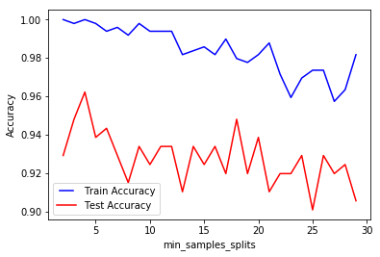
Machine Learning Classifier
Random-forest (Scikit-learn)
best test accuracy :: 0.9622641509433962
min sample split :: 4
estimators :: 16

Slide 18
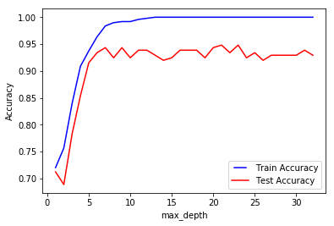
Machine Learning Classifier
Decision-Tree (Scikit-learn)
best test accuracy :: 0.9481132075471698
max depth :: 23

Slide 19
Machine Learning Classifier
Final Results - accuracy
Dataset / Classifier | KNN | Random forest | Decision tree
Iphone | 0.8940754039497307 | 0.9856373429084381 | 0.9730700179533214
Oneplus | 0.7594339622641509 | 0.9622641509433962 | 0.9481132075471698
all | 0.8645833333333334 | 0.9752604166666666 | 0.953125

Slide 20
Machine Learning algorithms
After we created the CSV file containing the vectors, we used the JAVA-ML open source library.
The algorithm we used is the k-Nearest Neighbors algorithm. “The Knn algorithm output is a class membership. An object is classified by a plurality vote of its neighbors, with the object being assigned to the class most common among its k nearest neighbors” (Wikipedia).
Another way to validate our results is using Cross-validation also provided by the JAVA-ML library.

Slide 21
Results
For this stage we tested three application:
Facebook
Amazon
CNN
The recordings was scattered over several dates in different times and both on Android and IOS.
The objectives was to identify the application at 70% accuracy .
We succeeded to reach our goals both in the java version and in the python version.

Slide 22
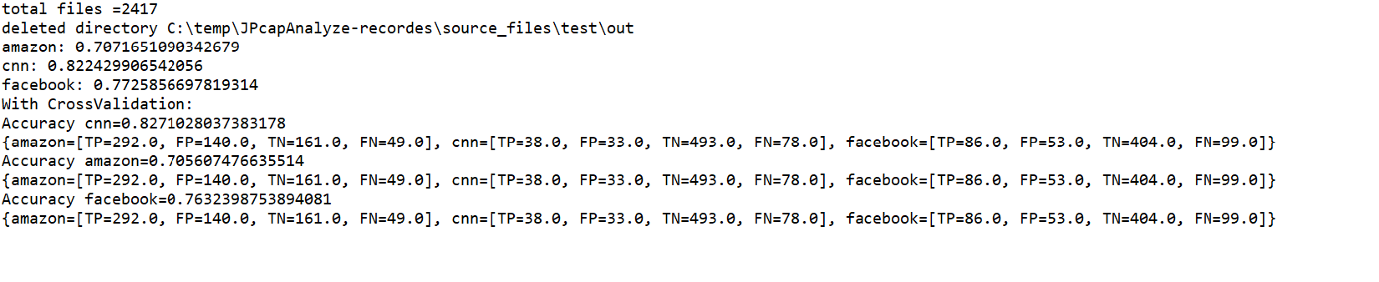
Results from JAVA-ML
Total session 2417 tested.

Slide 23
Results using python

Slide 24
Difficulties
In this project we had, and we still have several difficulties.
The first difficulty was regarding to the recording of the data, at first, we recorded using Wi-Fi and it didn’t gave us the requested results, the solution was the cooperation with Flash Networks.
That resulted a second problem, we had to manually use the apps, so the data set it is not large enough in scale.
The Pcap4j library retrieve only data up to the TCP layer, so we had to analyze manually that layer (by binary manipulation).
Currently the system run time is not fast enough to run-in real-time platforms.

Slide 25
Conclusions

Slide 26
Future Developments

